Slide 1

Crop Disease Detection Using CNN
Deep Learning for Healthy vs Non-Healthy Leaf Classification
By Dhananjay Patil

Slide 2
Problem Statement
Manual crop disease detection is time-consuming and error-prone
Crop diseases reduce agricultural productivity
Farmers need an automated solution to prevent yield loss
Need for an automated disease detection system.
Binary Classification: Healthy vs Diseased

Slide 3
Objective:
Build a deep learning model to classify plant leaves as Healthy or Non-Healthy
Enabling timely action and reducing crop loss.
Scope:
Detect diseases from leaf images
Can be extended to multiple crops and diseases
Deployable as a mobile/web application

Slide 4
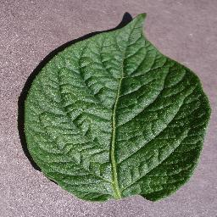
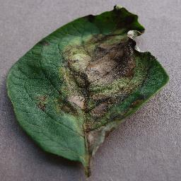
Dataset
Primary Data Source:
Plant Village dataset from Kaggle
Contains labeled images of crop leaves
Data Structure:
Healthy
Non-Healthy
Dataset Statistics:
Number of images per class
Image size standardized to 128×128

Slide 5
Plant Village
Tomato
Potato
Paper bell
Healthy
Target spot
mosaic virus
Yellow leaf
Bacterial spot
Early blight
Late blight
Leaf mold
Septoria leaf spot
spider mites
healthy
Bacterial spot
Healthy
- Early Blight
- late Blight

Slide 6

Data Preprocessing
Extracted dataset from zip file
Converted multi-class → Binary classification
Train / Validation / Test split:
70% Training, 15% Validation, 15% Testing
Applied data augmentation:
Rotation
Zoom
Horizontal flip

Slide 7
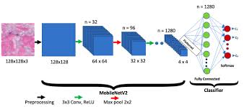
Methodology (Model Development Phase)
Data Augmentation
Applied rotation, zoom, and horizontal flip to training data
Improved model generalization and reduced overfitting
Model Selection
Used MobileNetV2 (Transfer Learning)
Pretrained on ImageNet dataset
Lightweight and efficient architecture

Slide 8
Methodology (Model Development Phase)
Model Building
Frozen base layers for faster training
Added GlobalAveragePooling layer
Final Dense layer with Sigmoid activation for
binary classification
Model Training
Optimizer: Adam
Loss Function: Binary Crossentropy
Trained for 15 epochs with validation monitoring
Model Compilation
Optimizer: Adam
Loss Function:
Binary Cross entropy
Metric: Accuracy
Trained for 15 epochs

Slide 9
Training & Validation Results
Final Training Performance
Training Accuracy: 98.36%
Training Loss: 0.0438
Validation Performance
Validation Accuracy: 97.54%
Validation Loss: 0.0698
No of epochs
15 epochs
Test Performance
Test Accuracy: 97.38%
Test Loss: 0.086

Slide 10
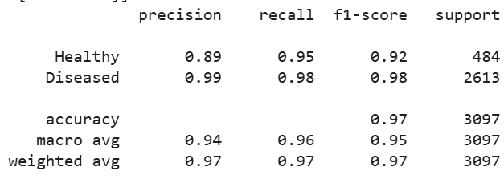
Evaluation Metrics
The model achieved 97% overall test accuracy,
High precision and recall for both classes indicate the model effectively distinguishes between Healthy and Diseased leaves.

Slide 11
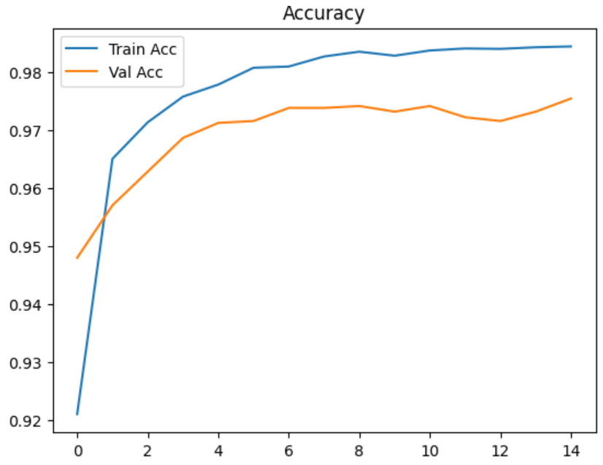
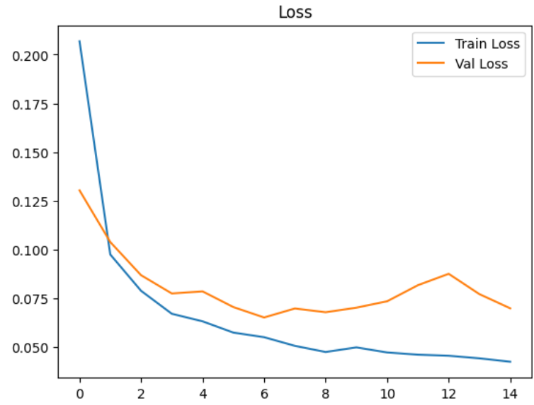
Plots:
Accuracy vs Epochs
Loss vs Epochs

Slide 12
CHALLENGES
Real-world image variation – Different lighting, backgrounds, and camera quality can affect prediction accuracy.
Data imbalance – Diseased images may be more than healthy ones (or vice versa), impacting model bias.
Similar disease patterns – Some diseases look visually similar, making classification difficult.
Deployment limitations – Running deep learning models on low-end mobile devices may require optimization.

Slide 13
CONCLUSION
Successfully built a binary crop disease classifier
Can assist farmers in early disease detection
An automated, accurate, and scalable alternative to manual inspection.
Demonstrating the practical application of deep learning in agriculture.

Slide 14
THANK YOU

